Slide 1
EE450: High Voltage Engineering
Lecture 1

Slide 2
Outline
Fundamentals of High Voltage Engineering
History of high voltages
Insulating materials
Voltage stresses
Need for high voltages
Testing voltages
High voltage engineering
Levels of high voltages
Applications of high voltage engineering

Slide 3
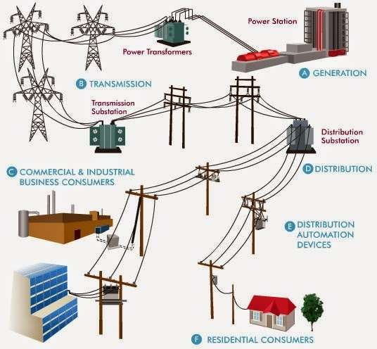
History of High Voltages
A high-voltage power system consists of a complex configuration of generators, long- distance transmission lines and localized distribution networks.
Figure 1: Typical power system

Slide 4
History of High Voltages
The first public power station was put into service in 1882 in London.
To produce direct current at low voltage
Its service was limited to highly localized areas
Used mainly for electric lighting
With the advent of the transformer, DC systems were quickly replaced by AC systems.
T he first major AC power station was commissioned in 1890 at Deptford.
To produce alternative current at high voltage of 10 kV
To supply power over a distance of 28 miles
However, in recent years high-voltage direct current (HVDC) transmission has regained some of its earlier popularity.

Slide 5
History of High Voltages
Advantages of HVDC:
HVDC provides an economic solution for interconnecting asynchronous AC systems (back-to-back installation)
HVDC permits a higher power density as compared to AC transmission
Disadvantages of HVDC:
Excessive station costs
Voltage transformation is not possible
Consequently, there is a critical distance (600 km - 800 km) at which DC transmission becomes more economical to adopt than AC.

Slide 6
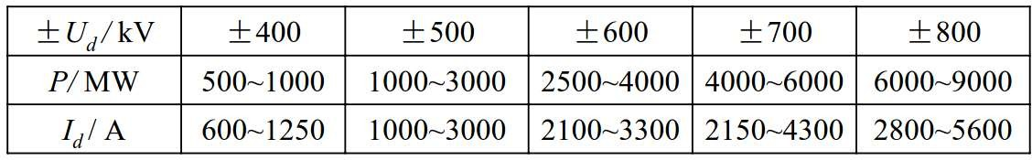
History of High Voltages
Power transfer capability P of a bipolar DC system is approximately given by,
P = 2 U_{d} I_{d}
where
U_{d} is the operating voltage of one line
I_{d} is the current flowing through the line.
Table 1: Power transfer capability of a DC system and its relationships with operating voltage

Slide 7
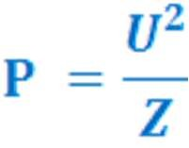
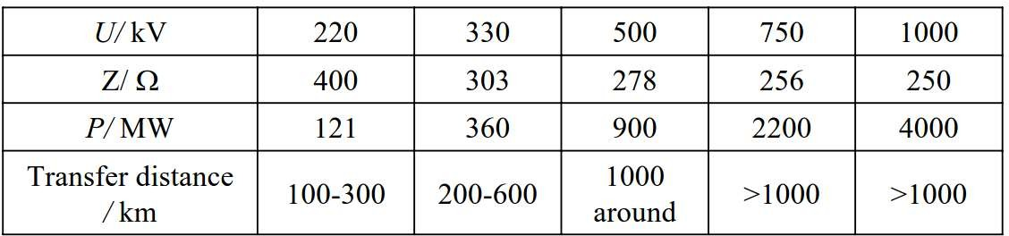
History of High Voltages
Power transfer capability P of an AC system is approximately given by,
where
U is the operating voltage.
Z is the wave impedance of a transmission line
Table 2: Power transfer capability of an AC system and its relationships with operating voltage and transfer distance

Slide 8
History of High Voltages
Over the last hundred years, the demand of electricity has drastically increased. To
meet the load demand, it is desirable to add more generation into the system.
This implies that the transmission lines need to carry bulk power over long distances.
Accordingly, the system voltage levels have steadily increased over the years to deliver more power.
For the same power, an increase in the voltage level results in:
Lower cost of conductor
Higher transmission efficiency
It is desirable to increase the transmission voltage, but this causes increased stresses on the insulation.

Slide 9
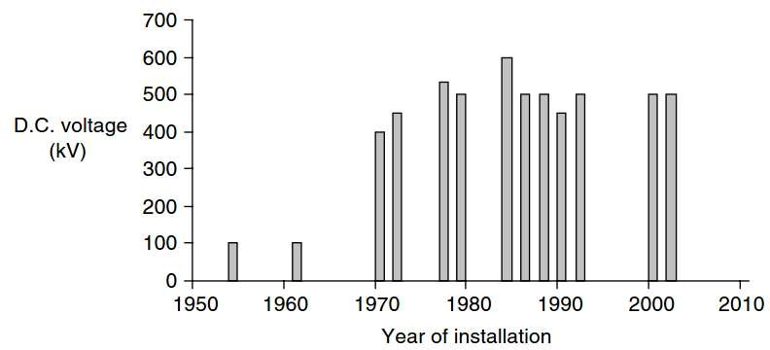
History of High Voltages
Figure 1: Major DC systems in chronological order of their installations

Slide 10
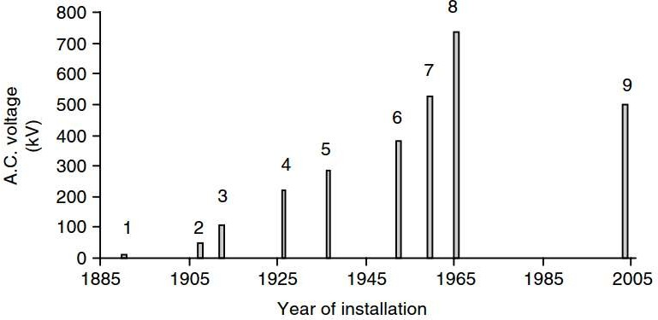
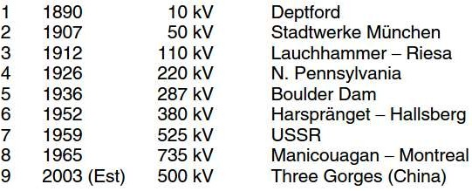
History of High Voltages
2008 1000 kV Jindongnan-Nanyang-Jingmin (China)
Figure 2: Major AC systems in chronological order of their installations

Slide 11
Insulating Materials
There are two major components in power systems:
Conductors that conduct electricity such as overhead lines, distribution lines, wires, cables, windings of machines etc.
Insulators that block the flow of current between live part and ground such as air in overhead lines, paper insulation applied over conductors of generators and transformers, SF₆ and vacuum in circuit breakers.
For the reliable operation of power system, we need proper insulation in the power system so that the current must be confined to flow through its intended path.

Slide 12
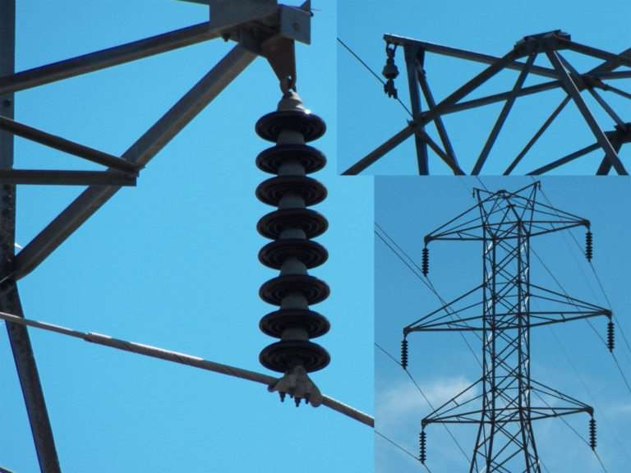
Insulating Materials

Slide 13
Insulating Materials
Therefore, a good understanding of insulation systems is essential to understand:
– Dielectric properties of the insulating materials
−
Physical phenomenon that leads to degradation and failure of insulating materials
– Diagnostic techniques required for evaluating and testing different insulating materials
High voltage engineering deals with the knowledge of the behaviour of dielectrics- insulating materials when subjected to high voltages.

Slide 14
Insulating Materials
Insulation materials are classified as: solids, liquids, gases and vacuum.
Solid dielectrics: most widely used are XLPE, PVC, ceramic, glass, rubber, resins, reinforced plastics, polypropylene, impregnated paper, wood, cotton, mica, pressboards, bakelite, perspex, ebonite, Teflon etc.
Liquid dielectrics: Petroleum oils are the most common insulating liquids. However, askarels, fluorocarbons, silicones, and organic esters including castor oil are used in high voltage equipment.
Gaseous dielectrics: Atmospheric air is the cheapest and most widely used dielectric. Other gaseous dielectrics are compressed gas at high pressure than atmospheric in power systems such as nitrogen, SF₆, and its mixture with CO₂ and N₂.

Slide 15
Insulating Materials
Vacuum: If the pressure inside a chamber is maintained below 10⁻⁴ torr, it may be considered as vacuum and provides excellent electrical insulation. Ideally, vacuum is the best insulator with field strengths up to 10⁷ V/cm.

Slide 16
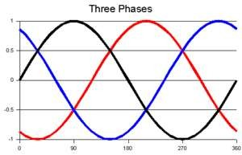
Voltage Stresses
Normal operating voltage
Operating voltage determines the dimensions of the insulation which forms part of electrical equipment.
Normal operating voltage does not severely stress the power system’s insulation. Only in special circumstances, for example under pollution conditions, may operating voltages cause problems to external insulation.

Slide 17
Voltage Stresses
Power systems are subjected to disturbances caused by;
Temporary (or sustained) overvoltages → ground ferroresonance etc.
Switching overvoltages → switching operations
Lightning overvoltages → lightning strikes
faults, load rejection, or
Transient overvoltages can reach up to 6 per unit (1 per unit = nominal voltage).

Slide 18
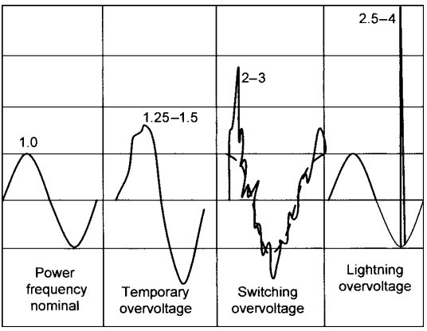
Voltage Stresses

Slide 19

Voltage Stresses
No. Type of Overvoltage
Shape Designation
Amplitude Range
Frequency Range
Causes
1.
Temporary overvoltages
Low- frequency oscillations
1.25 – 1.5 pu
0.1 Hz – 3 kHz
Ground faults Load rejection Ferranti effect Ferro-resonance
Fault interruption De-energization of capacitor banks Energization of lines Energization/de- energization of transformers
Lightning—cloud-to- ground flashes
Opening or closing of circuit breakers,
2.
Switching overvoltages
Slow front surges
2– 3 pu
50/60 Hz – 20
kHz
3.
Lightning overvoltages
Restrike overvoltages, GIS
Fast front surges
Very fast front surges
2.5 – 4 pu
10 kHz – 3
MHz
100 kHz – 50
MHz
4.
disconnecting switch
Page 19
and earthing switch etc.

Slide 20
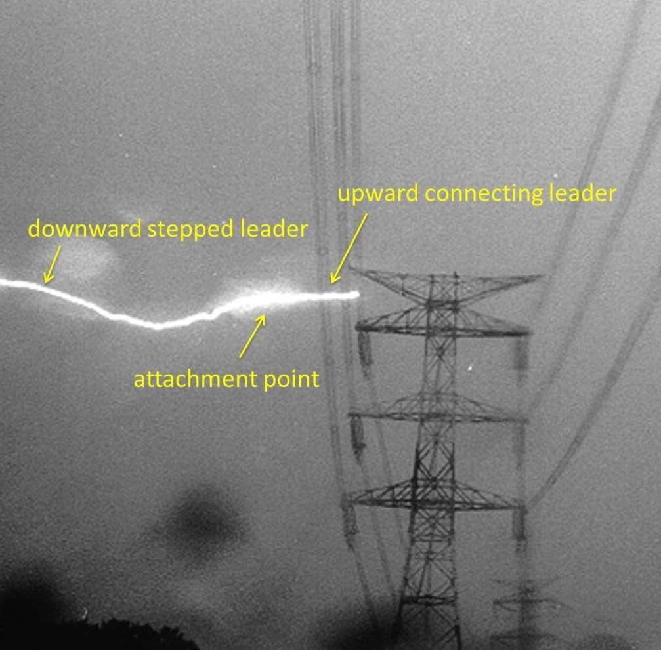
Voltage Stresses
Lightning strike to an UHV line
Page 20

Slide 21
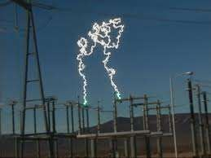
Voltage Stresses
500 kV disconnector opened under load
Page 21

Slide 22
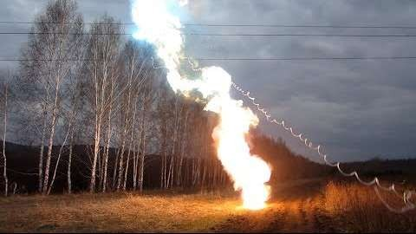
Voltage Stresses
Short-circuit on 110 kV power line
Page 22

Slide 23
Need for High Voltages
For the reliable operation of power system, equipment must be designed and tested at very high voltages.
It is necessary to test HV equipment during its development stage and prior to commissioning.
The magnitude and type of test voltage varies with the rated voltage of a particular apparatus.
Basic classification of testing voltages:
Testing with power frequency and low-frequency AC voltages
Testing with DC voltages
Testing with lightning impulse voltages
Testing with switching impulse voltages
Page 23

Slide 24
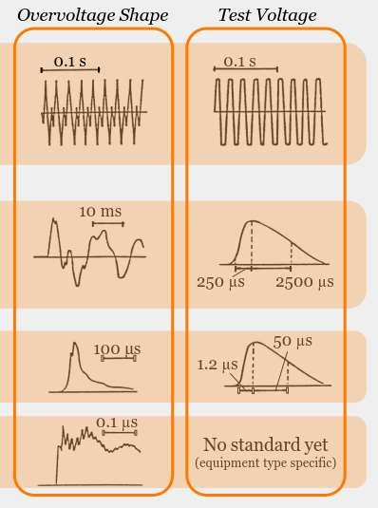
Testing Voltages
Temporary Overvoltages
Switching Overvoltages
Lightning Overvoltages
Very-fast Front Overvoltages
Page 24

Slide 25
High Voltage Engineering
High Voltage engineering consists of generation, measurement, and control of high voltages, dielectric discharges and electrical insulation breakdown, overvoltages and their protection, and electrical insulation condition monitoring and diagnosis, et al.
Overvoltages and insulation coordination in power systems
Dielectrics and electrical insulation
High voltage testing techniques
Page 25

Slide 26
High Voltage Engineering
Reliable insulation is related to the application of high voltage systems. Electrical insulation is the physical basis of high voltage engineering.
Insulation
High voltage tests ensure high voltage system to be operated safely.
HV generation? HV measurement? HV testing
Overvoltages may have much greater magnitudes than normal operating voltages. They do severely stress the insulation of power system.
HV testing techniques
Overvoltages
Page 26

Slide 27
Levels of High Voltage
Definition of High Voltage
IEC and its national counterparts (IET, IEEE, VDE, etc.) define high voltage
circuits as those with more than 1000 V for AC and at least 1500 V for DC.
In electric power transmission engineering, high voltage is usually considered any voltage over approximately 35 kV.
DC systems:
HVDC levels: 600 kV and below UHVDC levels: above 600 kV
Page 27

Slide 28

Levels of High Voltage
Table: Voltage Classification for HVAC systems
Voltage Class
Voltage Range
Low voltage (LV)
V ≤ 1 kV
Medium voltage (MV)
1 kV < V ≤ 66 kV
High voltage (HV)
66 kV < V ≤ 220 kV
Extra high voltage (EHV)
220 kV < V ≤ 800 kV
Ultra high voltage (UHV)
V > 800 kV
Page 28

Slide 29
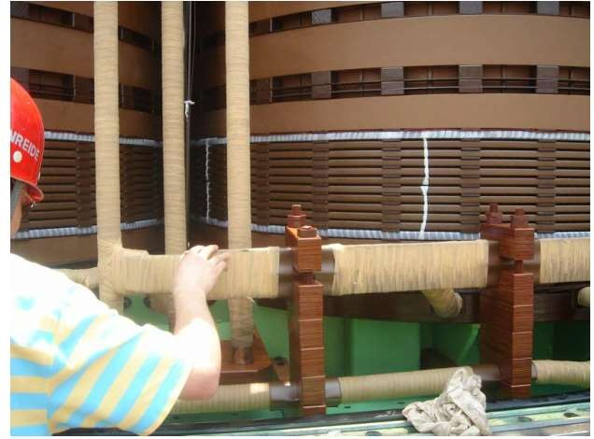
Applications of High Voltage Engineering
Windings of a 220-kV transformer
Page 29

Slide 30
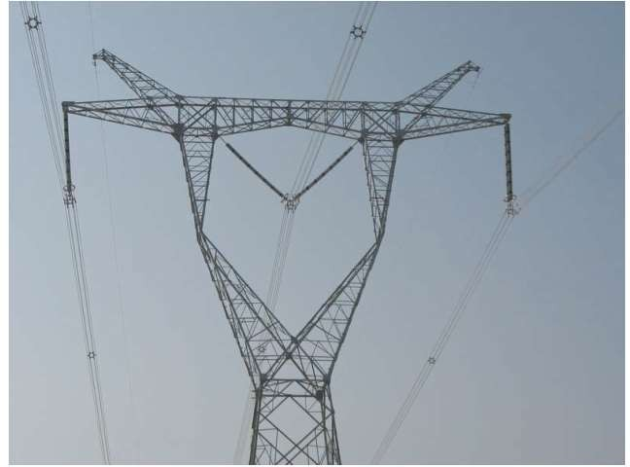
Applications of High Voltage Engineering
750-kV transmission line
Page 30

Slide 31
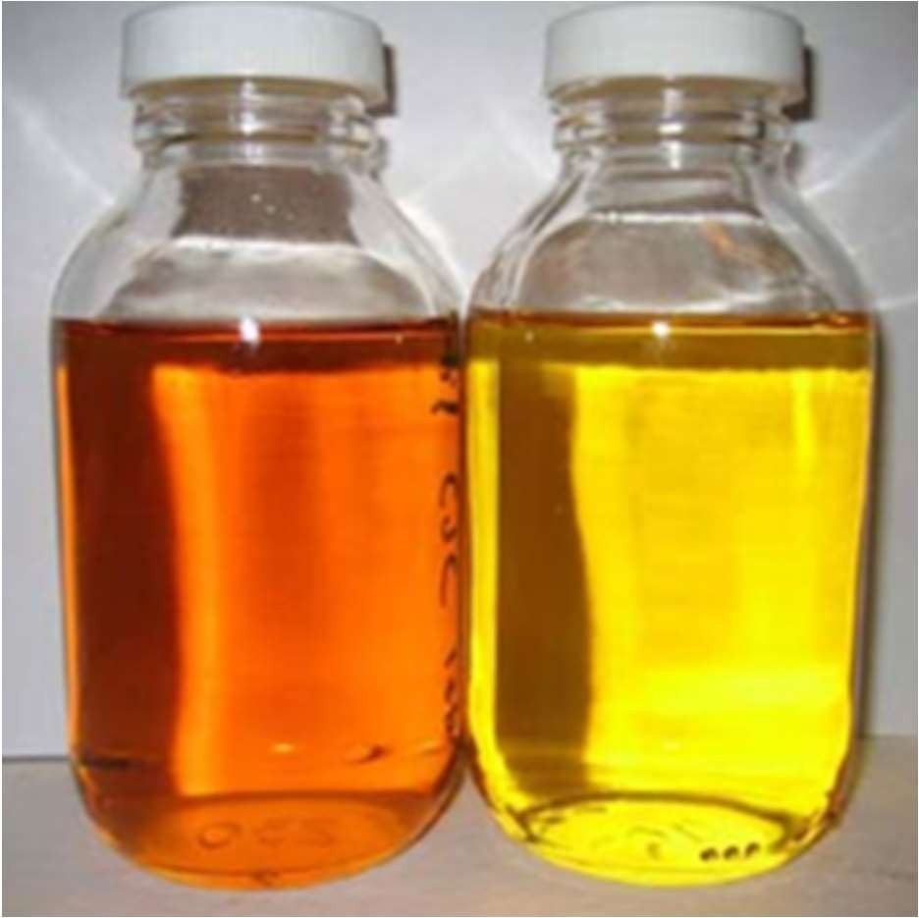
Applications of High Voltage Engineering
Mineral oil in transformer
Page 31

Slide 32
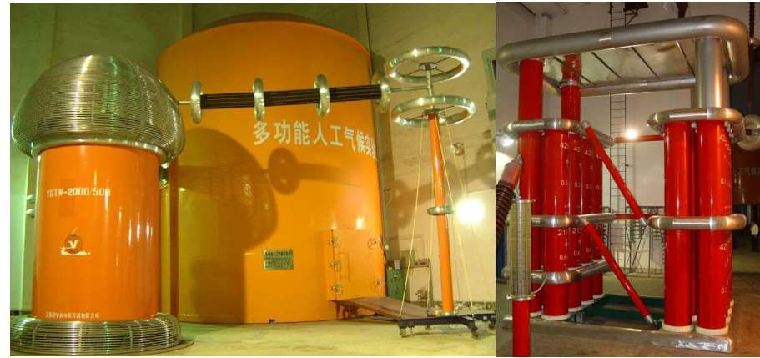
Applications of High Voltage Engineering
AC testing transformer (left) and DC voltage generator (right)
Page 32

Slide 33
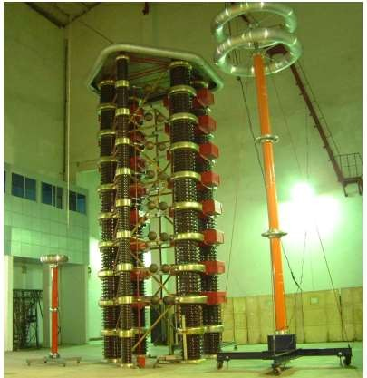
Applications of High Voltage Engineering
Impulse voltage generator
Page 33

Slide 34
Page 34

